Slide 1


Slide 2
THE SUNSET ROOM IS OPERATED BY
The Electric Company
Jason Hicks, General Manager/Owner
Ellie Little, Director of Events
DESIGNED BY
Claire Zinnecker Design & Xavier Schipani

Slide 3
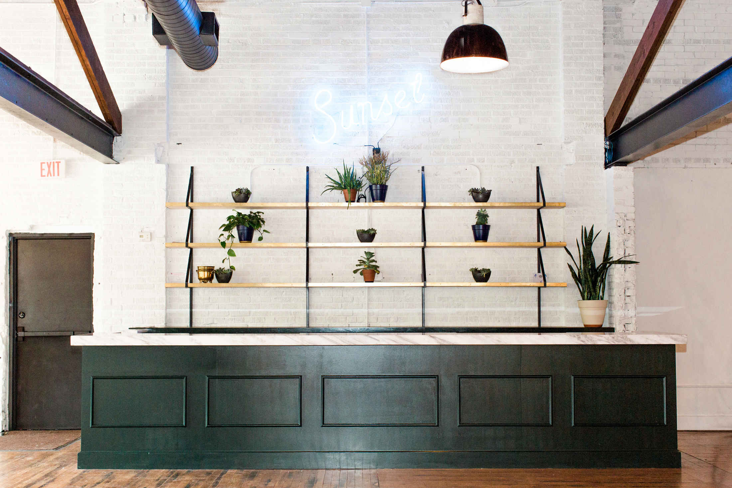
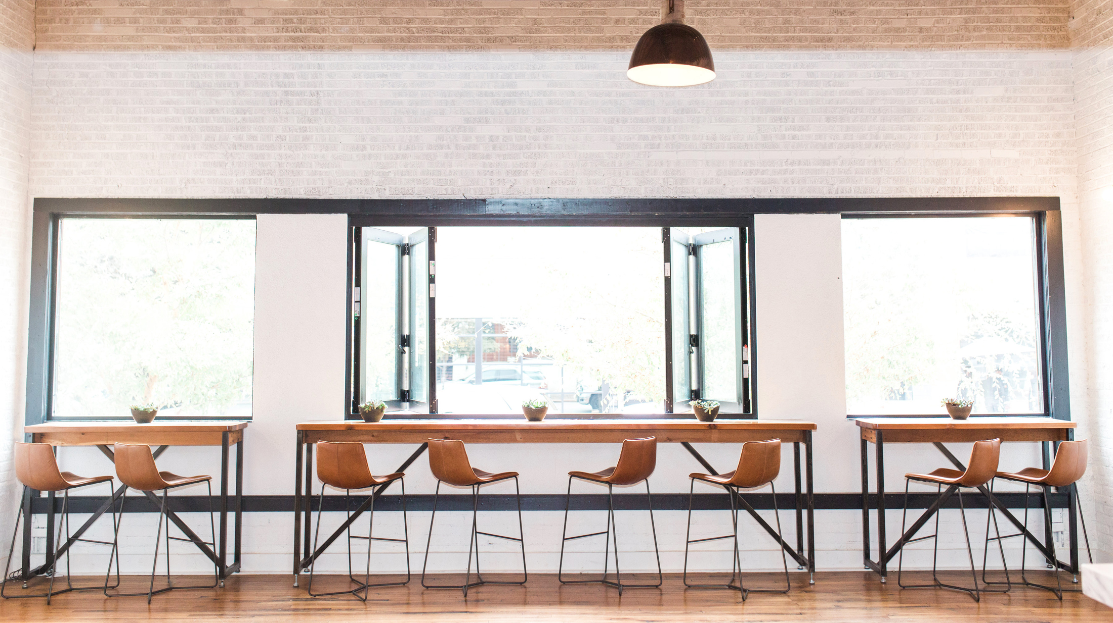
The Sunset Room is a
gallery-style event space in the
heart of Austin's Convention Center
and Historic Sixth Street Districts.
With exposed brick walls, original wood rafters and longleaf pine floors, the airy and inviting space is designed for maximum flexibility ready to accommodate virtually any occasion.

Slide 4
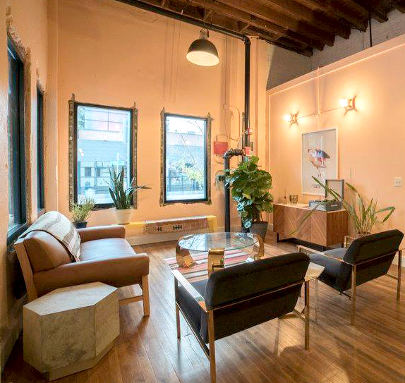
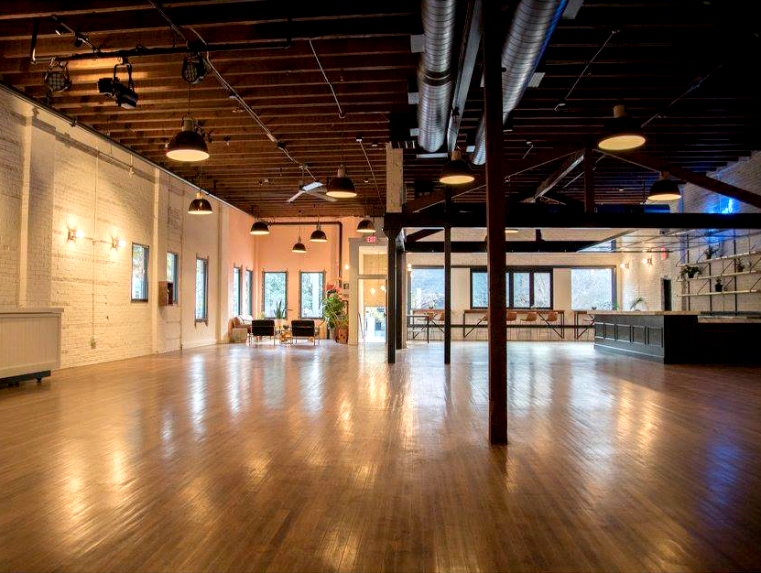
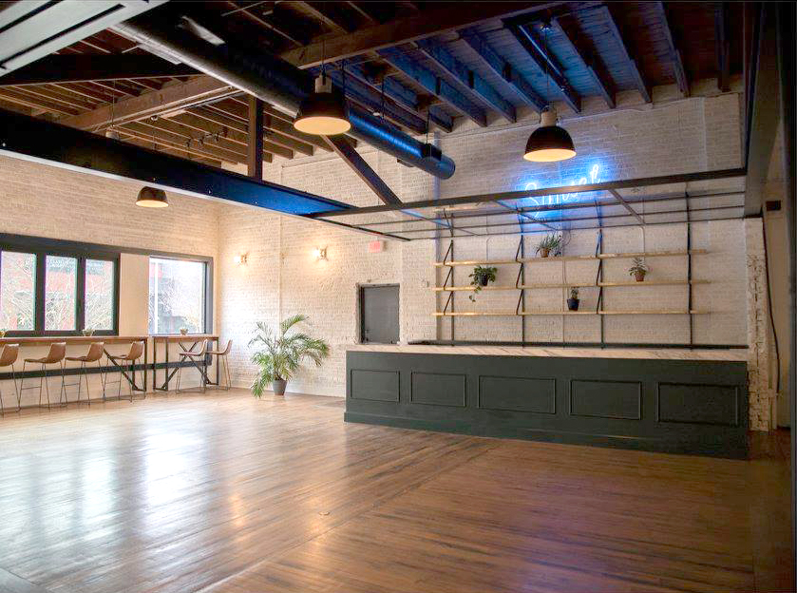
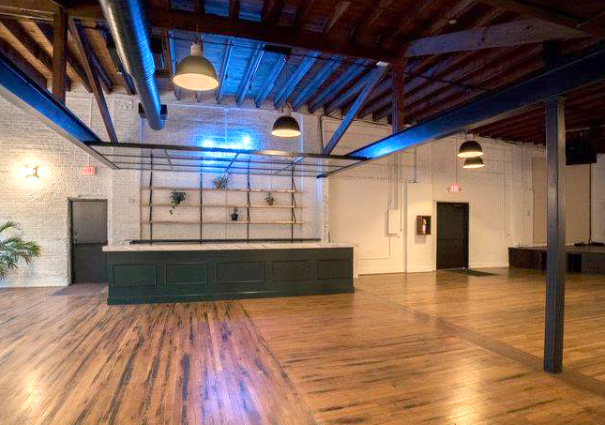
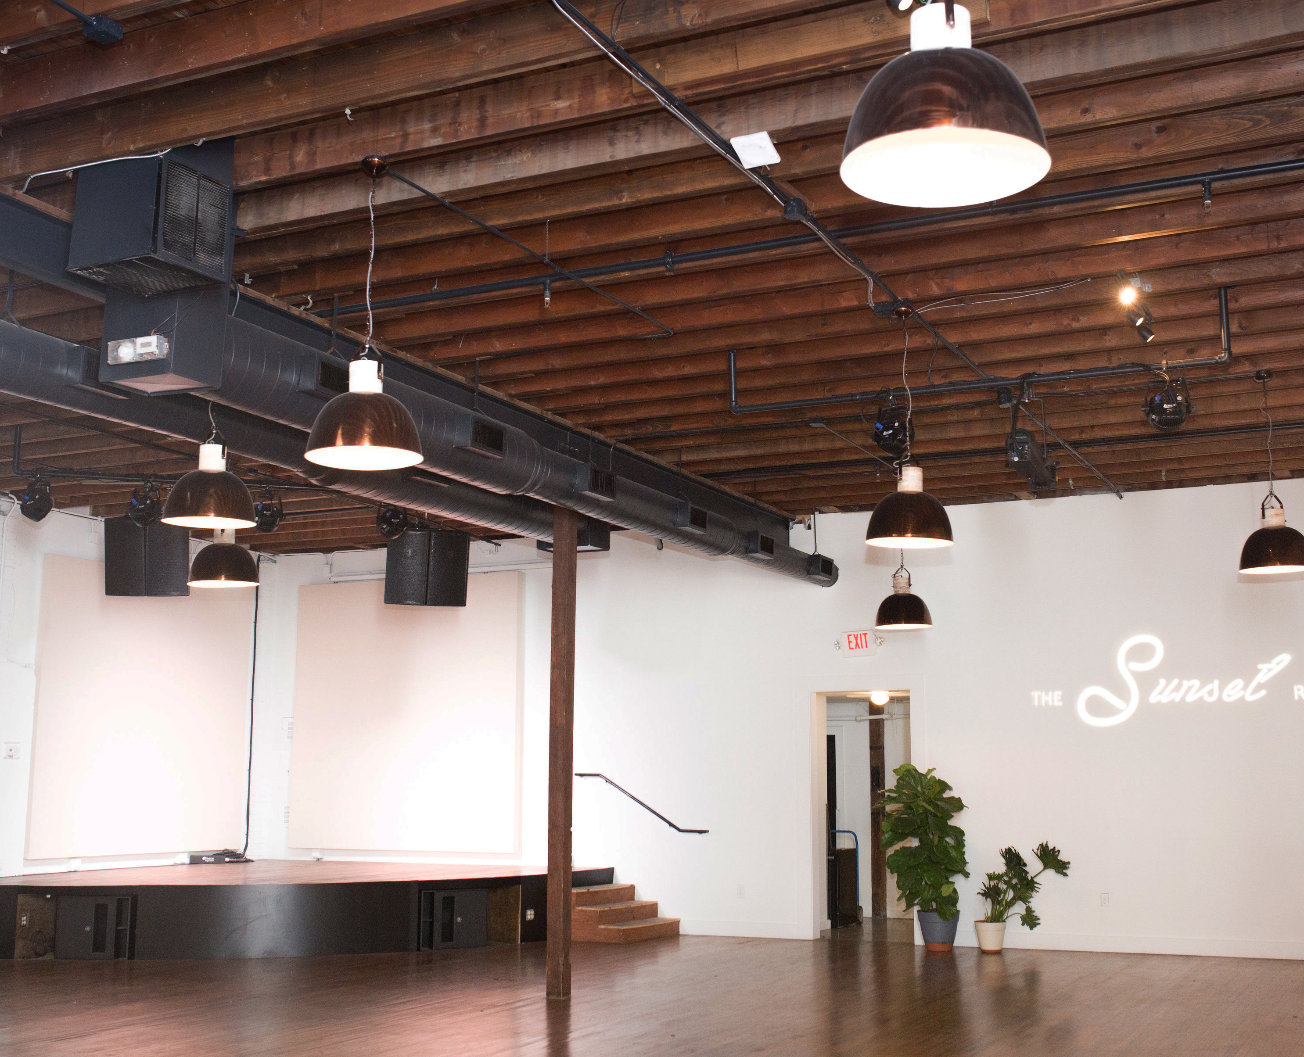

Slide 5
SPECS & FEATURES
INDOOR/OUTDOOR AREA
• 3709 square feet indoor space
• 45 x 45 ft gravel lot on north side
CAPACITY
• Standing capacity (no furniture): 400
• Standard cocktail capacity: 325
• Theatre capacity: 250
• Seated banquet capacity: 175
ADJACENT LOT
• 3900 square fee outdoor space on west side
Available as extension of the interior for additional fee
• Can be tented
• Capacity: 300
All capacities subject to change pending final event
layout and Fire Marshal approval
FEATURES
• Building maintains much of it's original 1930s
features, including longleaf pine flooring,
exposed brick walls and wood rafter ceiling
• Basic WiFi (can be boosted for high user count/
live streaming)
• ADA compliant
• Prime location in the heart of the Convention
Center and Historic Sixth Street Districts
FOOD & BEVERAGE
• In-house beverage vendor coordinates all
beverage packages and bar staffing
• Venue can operate as a licensed or
unlicensed venue
• Outside caterers are welcome with approval
from The Sunset Room

Slide 6
SOUND, PRODUCTION, LIGHTING
SOUND
• Mackie 1608 16 Channel Mixer with
wireless Ioad control
• 3 per side flown JBL VP7212 mains
• 2 delay speakers for the rest of venue
• 2 single Yamaha 18” Subs
PRODUCTION
• 13-16’ high ceiling with several built-in
rigging beams
• Built-in 22-foot wide quarter round stage
• 400 amps — 3-phase power
STAGE LIGHTING
• Full color spectrum stage color wash
• Gobo wall for custom gobo presentation
with full color LED loko for complimentary
gobo color wash
• Six Gallery Lighting Vignettes
HOUSE LIGHTING
• 18 Philips Hue white and color ambiance
A19 smart LED light bulbs
HOUSE LIGHTING CONTROL
• Full control via luminaire 3 App for custom color
effects Philips Hue Bridge

Slide 7
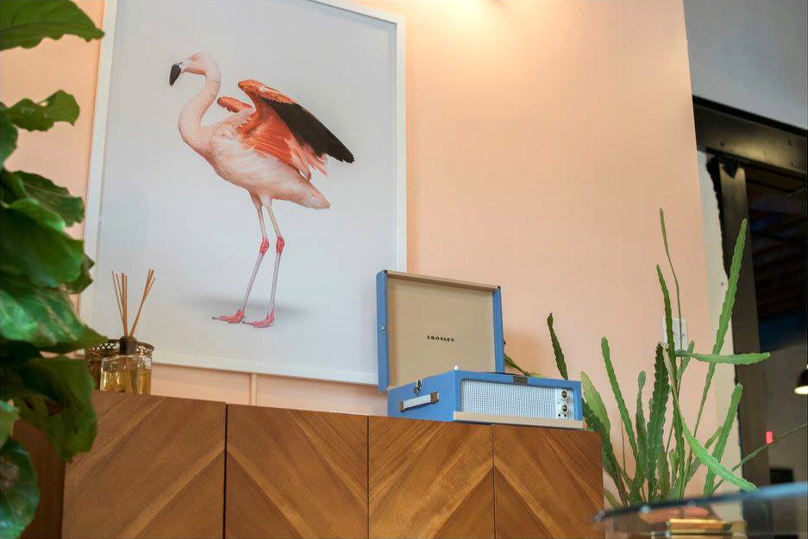
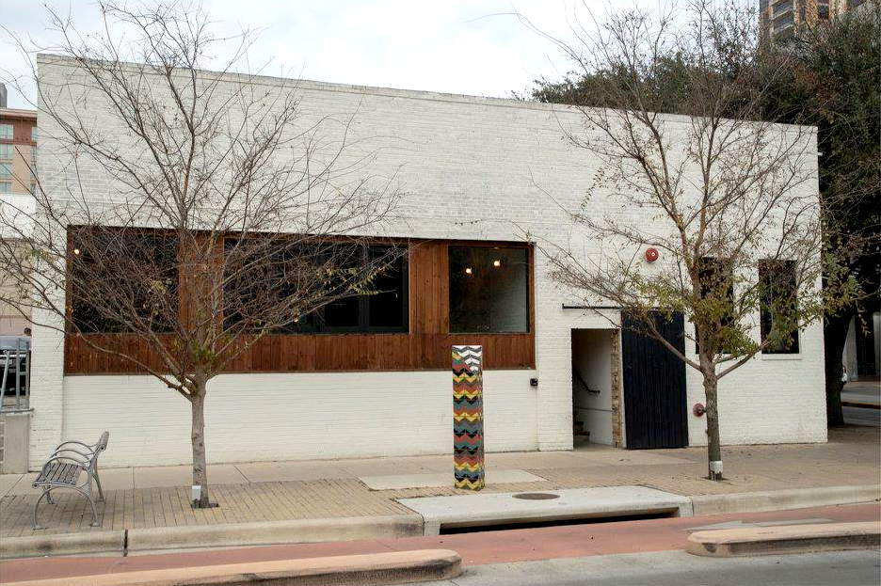
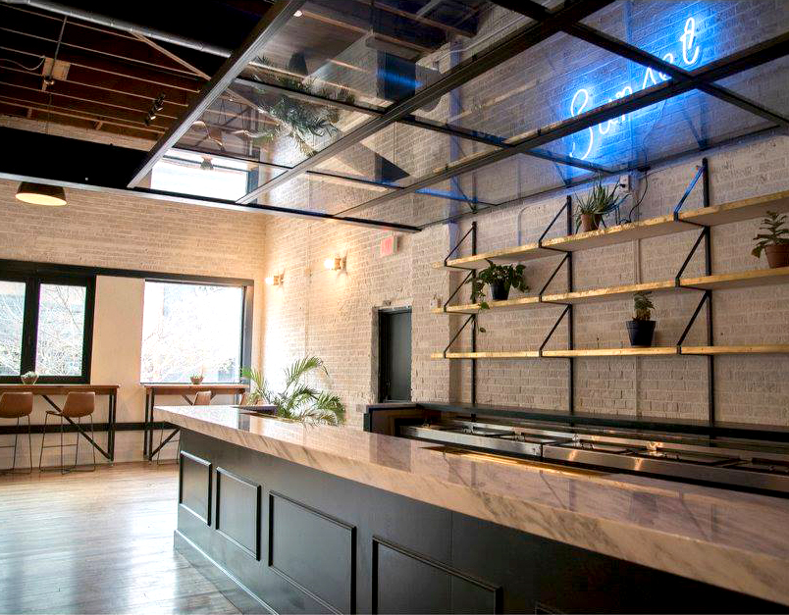
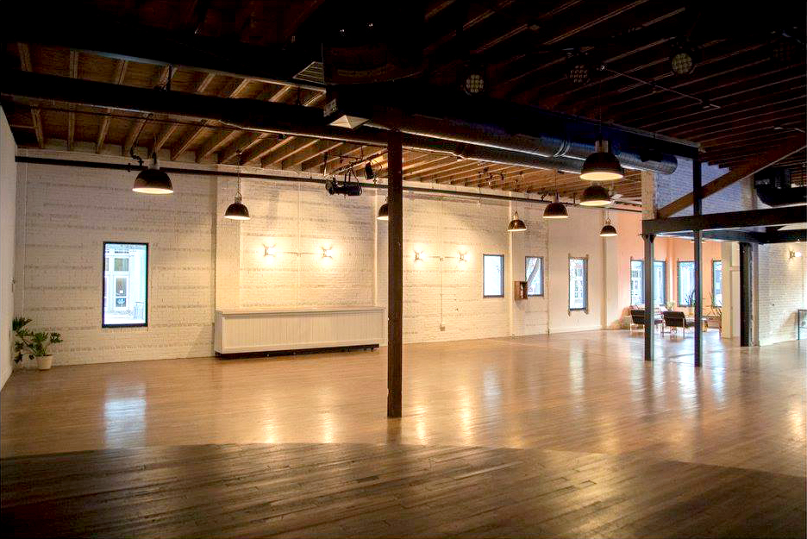

Slide 8
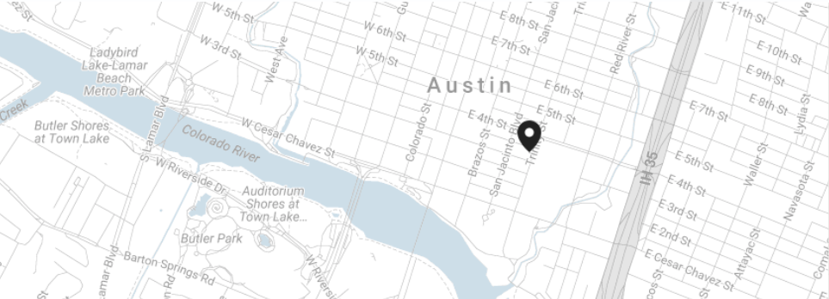
310 EAST 3RD ST
AUSTIN, TX 78701

Slide 9
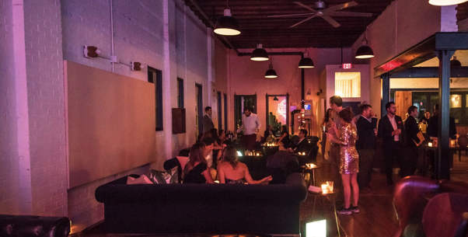
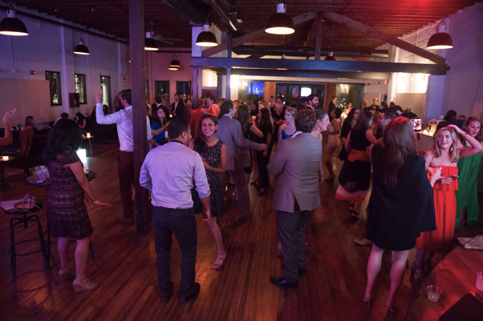
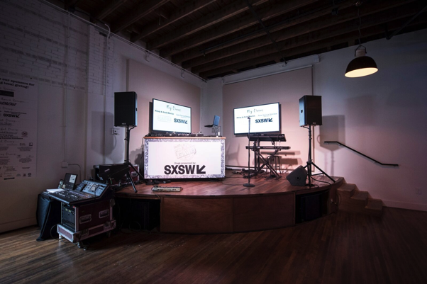
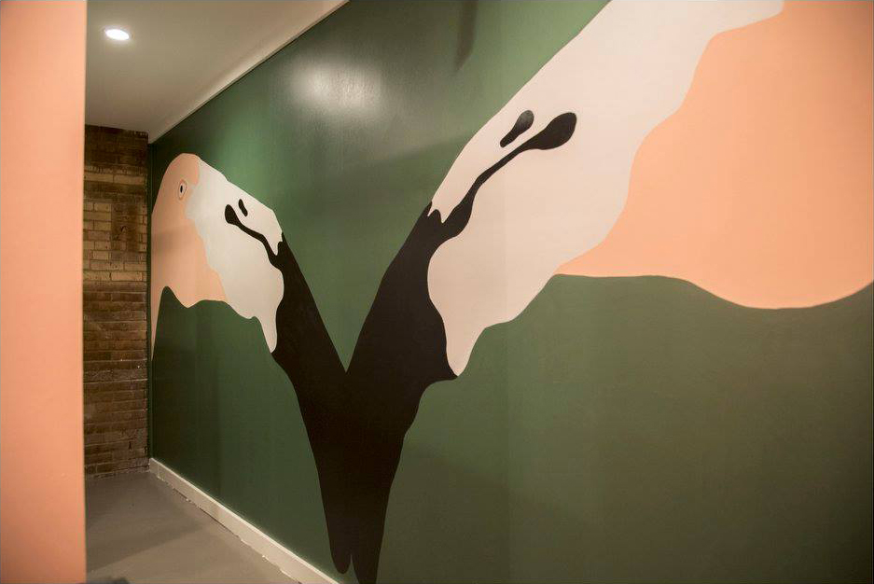
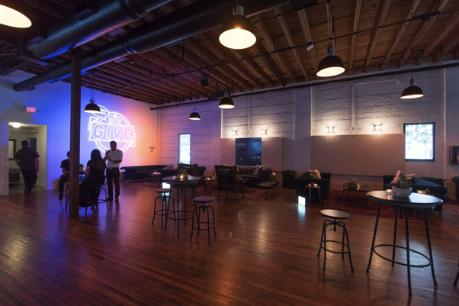
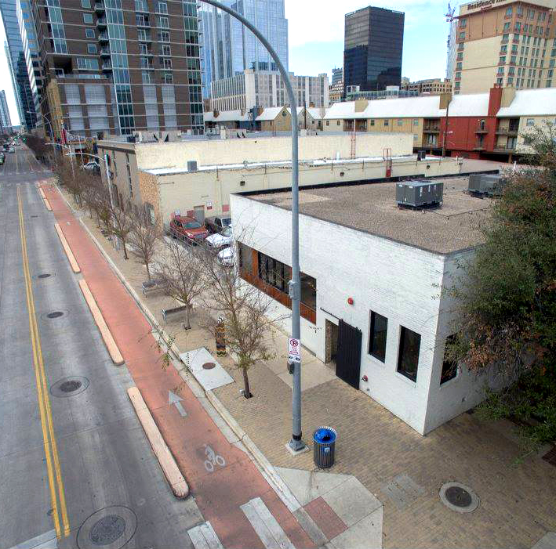

Slide 10
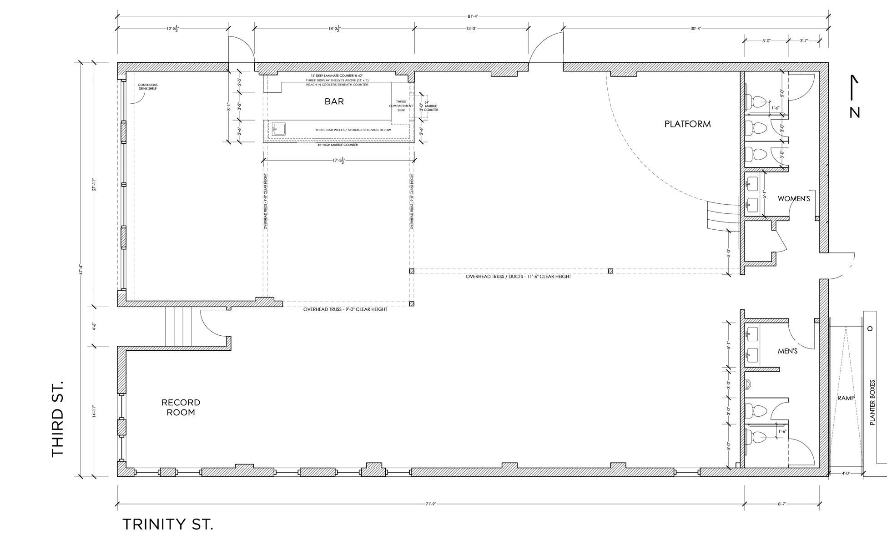

Slide 11

LET’S CONNECT!
For pricing information, please review our
venue spec & pricing sheet.
For custom proposals, please fill out our venue inquiry.
For further inquiries or to book the The Sunset Room, please contact
ELLIE LITTLE
ellie@thesunsetroomaustin.com • (512) 694–5938

